Slide 1
Hospital User/Technology Management System
Anassas Anderson and Sam Dominguez

Slide 2
Application Domain - Hospital Management System
Hospitals have to be able to deal with an array of situations from children stubbing their toe to life threatening diseases that have never been seen before.
In order to run an effective hospital, proper documentation must be done on all patients coming in and out. The documentation would include procedures, medicines, time spent in hospital, and various other.
A hospital also serves as a business for stakeholders who benefit from the services necessary to run a hospital.
Current means of information management include filing cabinets with little to no organization.

Slide 3
Need For Application
Track amount of medicine being supplied to the hospital
Provide centralized location for patient data
Ensure that the appropriate equipment is supplied to each department
Record who works on what equipment as well as who operated on what patient
Makes sure that departments are properly staffed to work on the current number of patients
Manage the workload of the nurses and technicians

Slide 4
Entities
People
Nurses
Doctors
Patients
Technicians
Medical Equipment
Diagnosis
Medicine
Surgery
Prescription
Report
Order
Department
Things
Places
Medical Equipment Company
Insurance
Pharmacy
Notes:
Here are our three types of entities
People are the users that interact within the hospital.
Things are the some of the means of interaction between the users
Places act as a third party that works externally from the hospital. They are seen as the stakeholders that have a vested interest in the hospital

Slide 5
Relationships
A nurse will work for a specific department, monitor their patients, and assist with surgeries.
The doctor is responsible for generating diagnosis, performing surgery, and prescribing a prescription for his assigned patient. The doctor is also connected to a specific department. They will order for medical technicians to operate medical equipment.
The medical equipment is supplied by a Medical Equipment Company. The medical equipment is used to generate a report. The report will have a status of complete or not attached to when the order was placed.
A pharmaceutical company will be utilized to supply medicine used to fill the prescription.
The patient will receive a diagnosis. Based on the Report, the patient will receive a diagnosis. There services will be insured by an insurance company. The patient will be have surgery operations.

Slide 6
Constraints
Each patient should have one and only one doctor assigned to them as well as one and only one nurse monitoring them.
The patient should also have one and only one insurance provider
Doctors must have at least one patient.
Medical technicians can specialize on one and only one piece of medical equipment and each piece of medical equipment should be operated by no more than three medical technicians.
There can be one and only one doctor performing a surgery and there must be at least one nurse present but only a maximum of four nurses.
Additionally, each of the hospital staff(Doctor, Nurse, Medical Technician) should only be apart of one department.

Slide 7
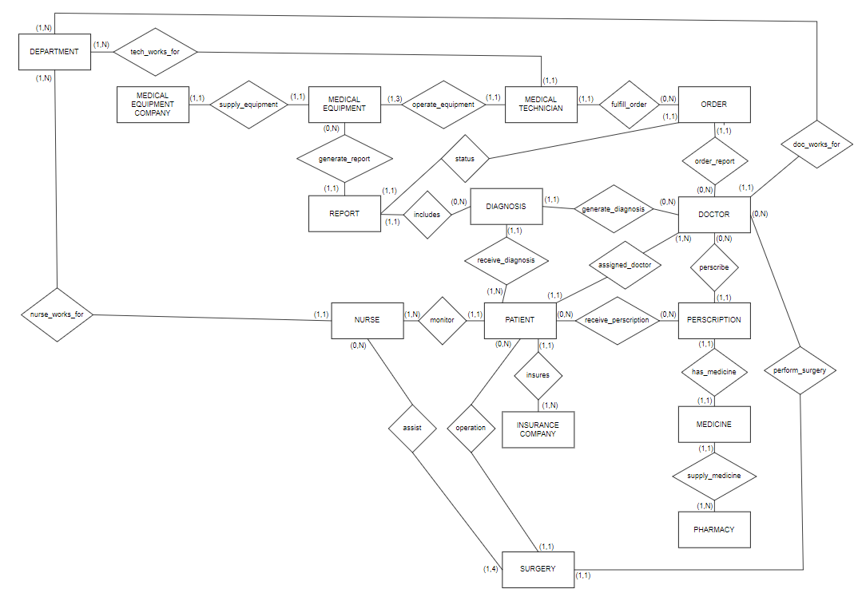
ER Diagram
Notes:
Things to note:
All binary relationships
Min Max notation
All entities, relationships, and constraints previously mentioned are present

Slide 8
Schema
PEOPLE
THINGS
Medical Technician (HOSP_ID, EQUIPMENT_SPECIALTY, EXPERIENCE)
Prescription (PER_ID,REFILLS)
Patient (SSN, NAME, AGE)
Order (ORDER_ID, REQUESTED_SCAN, DATE)
Nurse (HOSP_ID, NAME, EXPERIENCE)
Department (DEPT_NAME, DEP_LOCATION)
Doctor (HOSP_ID, NAME, SPECIALTY, EXPERIENCE)
Surgery (SURGERY_ID, PROCEDURE, OP_TIME, OP_DOCTOR)
PLACES
Diagnosis (DIAG_ID, TREATMENT, RECOVERY_TIME)
Medical Equipment Company (COMP_ NAME, ADDRESS, PHONE_NUMBER)
Report (REPORT_NUM, TEST_SUCCESS, RESULTS)
Insurance Company (INSURANCE_ID, COMPANY_NAME, COST)
Medicine (DRUG_NAME, STOCK_QUANTITY, EXPIRATION_DATE)
Pharmacy (COMP_NAME, ADDRESS, PHONE_NUMBER)
Medical Equipment (PART_NUM, COST)
Notes:
Things to note:
Every relation has a primary key so no weak entities
Mention 3 categories again

Slide 9
Timeline
All tasks will be split up evenly

